Slide 1

Introduction to Python Programming
Lesson : Control Statements
Ms. Shital H. Dinde

Slide 2
Control Statements
In general, statements are executed sequentially, top to bottom.
There are many instances when you want to break away from this e.g,
Branch point: choose to go in one direction or another based on meeting some condition.
Repeat: You may want to execute a block of code several times.
Programming languages provide various control structures that allow for more complicated execution paths.
Here we will focus on two such examples
conditionals and
loops

Slide 3
Conditional Statements
Sometimes the programmer needs to check the evaluation of certain expression(s), whether the expression(s) evaluate to True or False.
If the expression evaluates to False, then the program execution follows a different path then it would have if the expression had evaluated to True.
Based on this, the conditional statements are further classified into following types;
If
If-else
If-elif-else
nested

Slide 4
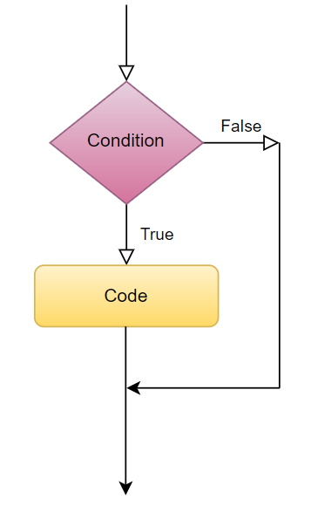
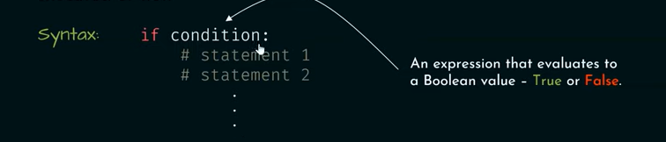
Simple If
simple if statement works on following principle,
execute the block of code inside if statement if the expression evaluates True.
ignore the block of code inside if statement if the expression evaluates False and return to the code outside if statement.

Slide 5
applePrice = 180
budget = 200
if (applePrice <= budget):
print("Alexa, add 1kg Apples to the cart.")

Slide 6
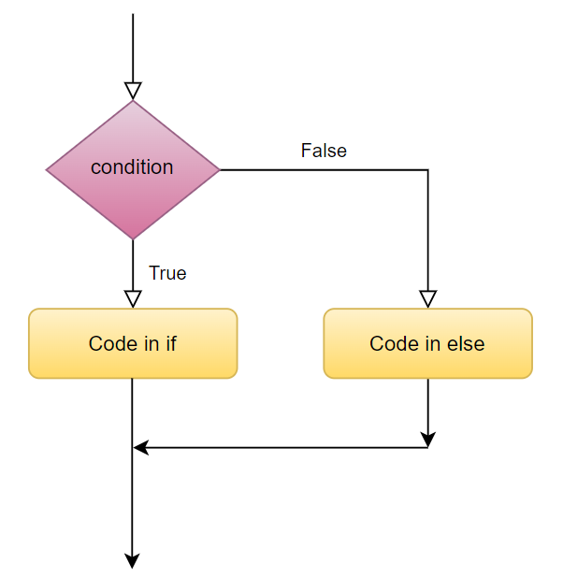
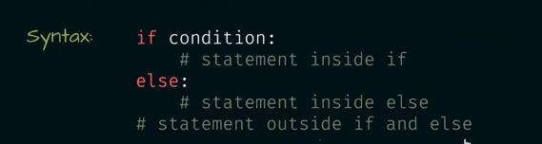
If-else
if –else statement works on following principle,
execute the block of code inside if statement if the expression evaluates True. After execution return to the code out of the if……else block.
execute the block of code inside else statement if the expression evaluates False. After execution return to the code out of the if……else block.

Slide 7
applePrice = 210
budget = 200
if (applePrice <= budget):
print("Alexa, add 1kg Apples to the cart.")
else:
print("Alexa, do not add Apples to the cart.")

Slide 8
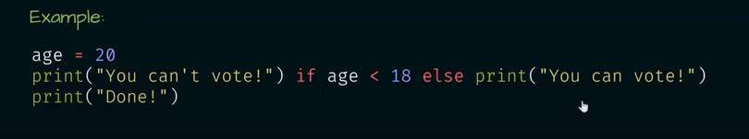
Short hand notation for if-else

Slide 9
elif Statement
Sometimes, the programmer may want to evaluate more than one condition, this can be done using an elif statement.
elif statement works on following principle,
execute the block of code inside if statement if the initial expression evaluates to True. After execution return to the code out of the if block.
execute the block of code inside the first elif statement if the expression inside it evaluates True. After execution return to the code out of the if block.
execute the block of code inside the second elif statement if the expression inside it evaluates True. After execution return to the code out of the if block.
……
execute the block of code inside else statement if none of the expression evaluates to True. After execution return to the code out of the if block.

Slide 10
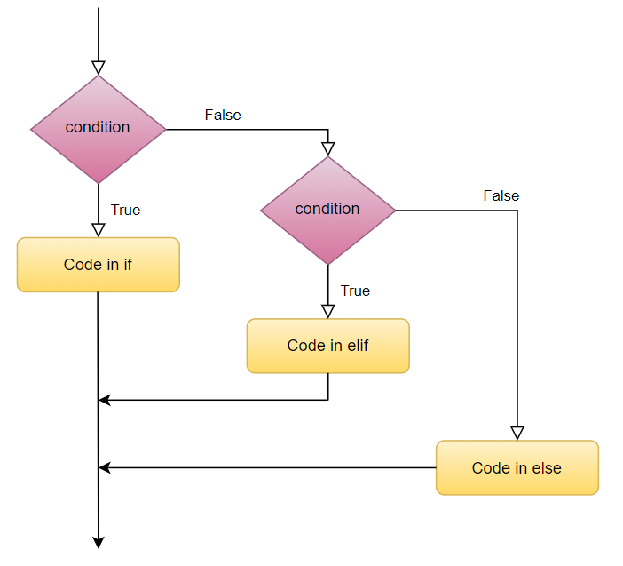

Slide 11
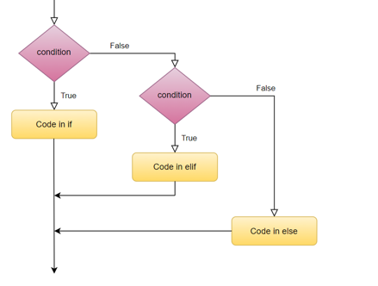
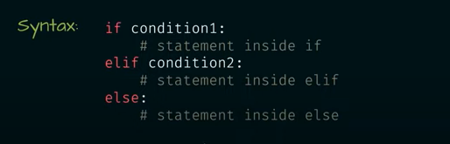

Slide 12
num = 0
if (num < 0):
print("Number is negative.")
elif (num == 0):
print("Number is Zero.")
else:
print("Number is positive.")

Slide 13
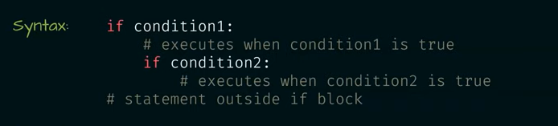
nested Statements
You may want to check for another condition after a condition resolves to TRUE. Here you can use the nested if construct.
In a nested if construct, you can have an if...elif...else construct inside another if...elif...else

Slide 14
num = 18
if (num < 0):
print("Number is negative.")
elif (num > 0):
if (num <= 10):
print("Number is between 1-10")
elif (num > 10 and num <= 20):
print("Number is between 11-20")
else:
print("Number is greater than 20")
else:
print("Number is zero")

Slide 15
Loop Statements
Sometimes a programmer wants to execute a group of statements a certain number of times.
This can be done using loops.
Based on this loops are further classified into following types;
for loop,
while loop,
nested loops

Slide 16
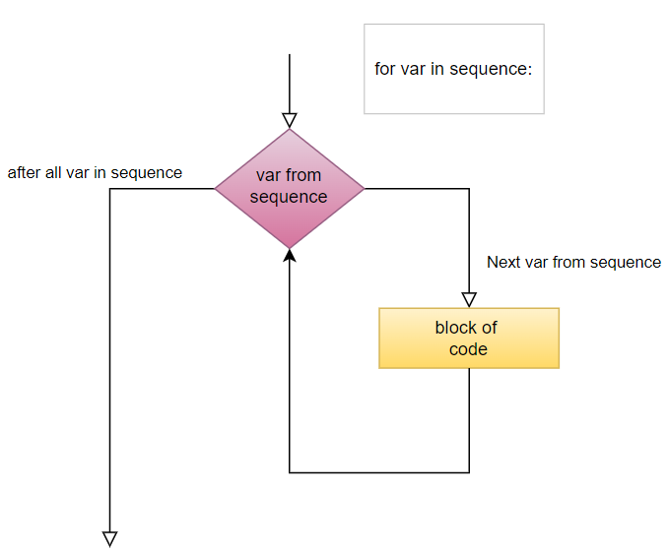
For loop
for loops are traditionally used when you have a piece of code which you want to repeat number of times.
for loops can iterate over a sequence of iterable objects in python.
Iterating over a sequence is nothing but iterating over strings, lists, tuples, sets and dictionaries.

Slide 17
for letter in 'Python': # loops for each character in string
print 'Current Letter :', letter
fruits = ['banana', 'apple', 'mango']
for fruit in fruits: # loops for each element in list
print 'Current fruit :', fruit
for index in range(len(fruits)): # loops for each element in list
print 'Current fruit :', fruits[index]
FruitsA=[x for x in fruits if x[0]==‘a’] # returns [‘apple’]

Slide 18
range()
The range() function creates a list of numbers determined by the input parameters.
range([start,] stop[, step]) -> list of integers
When step is given, it specifies the increment (or decrement).
>>> range(5)
[0, 1, 2, 3, 4]
>>> range(5, 10)
[5, 6, 7, 8, 9]
>>> range(0, 10, 2)
[0, 2, 4, 6, 8]

Slide 19
e.g. How to get every second element in a list?
for i in range(0, len(data), 2):
print data[i]

Slide 20
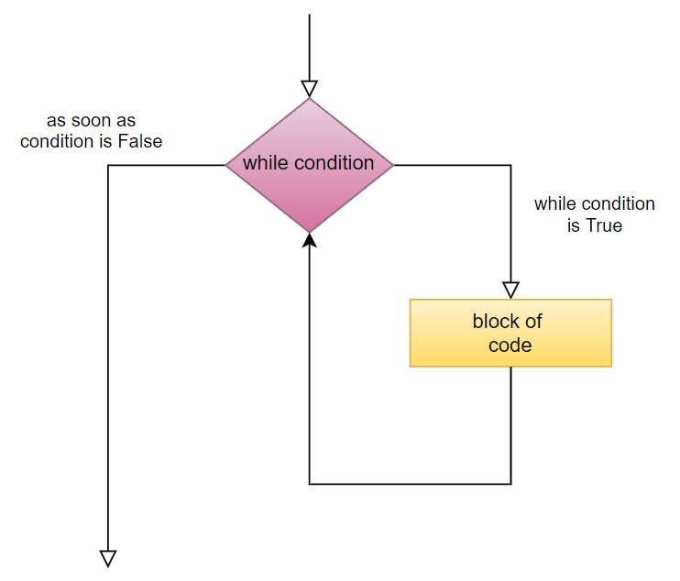
While loop
As an alternative, there is the while Loop, the while loop is used when a condition is to be met, or if you want a piece of code to repeat forever.

Slide 21
count = 5
while (count > 0):
print(count)
count = count - 1

Slide 22
While loop
while expression: #while TRUE execute block of statements
<Block of statements>
var = 1
while var == 1 : # This constructs an infinite loop
num = input("Enter a number :")
print ("You entered: ", num)
if num=='Q': # This gives a route out of loop
print (“Goodbye”)
break # break will terminate the loop

Slide 23
We can even use the else statement with the while loop.
Essentially what the else statement does is that as soon as the while loop condition becomes False, the interpreter comes out of the while loop and the else statement is executed.
x = 5
while (x > 0):
print(x)
x = x - 1
else:
print('counter is 0')

Slide 24
Nested loop
We can use loops inside other loops, such types of loops are called as nested loops.
while (i<=3):
for k in range(1, 4):
print(i, "*", k, "=", (i*k))
i = i + 1
print()

Slide 25
There are three control statements that can be used with for and while loops to alter their behavior.
They are
pass,
continue
break.

Slide 26
pass
Whenever loops, functions, if statements, classes, etc are created, it is needed that we should write a block of code in it.
An empty code inside loop, if statement or function will give an error.
To avoid such an error and to continue the code execution, pass statement is used.
pass statement acts as a placeholder for future code.

Slide 27
i = 1
while (i<5):
pass
for j in range(5):
pass
if (i == 2):
pass

Slide 28
continue
This keyword is used in loops to end the current iteration and continue the next iteration of the loop.
Sometimes within a loop, we might need to skip a specific iteration.
This can be done using the continue keyword
for i in range(1,10):
if(i%2 == 0):
continue
print(i)

Slide 29
break
The break keyword is used to bring the interpreter out of the loop and into the main body of the program.
Whenever the break keyword is used, the loop is terminated and the interpreter starts executing the next series of statements within the main program
for i in range(1, 10):
print(i)
if (i == 5):
break

Slide 30
Write a program to print multiplication table for any number
Write a Python program which iterates the integers from 1 to 50. For multiples of three print "Fizz" instead of the number and for the multiples of five print "Buzz". For numbers which are multiples of both three and five print "FizzBuzz".
Write a program to print all prime numbers in range of 2300 to 4000

Slide 31
4. Write a program which will find all such numbers which are divisible by 7 but are not a multiple of 5, between 2000 and 3200 (both included).

Slide 32


Questions?

Slide 33

8888 763 563
88 5335 4141
https://svlautomations.in
https://svltrainings.in

